Slide 1


<Name>
<Date>

Slide 2

Outline
Executive Summary
Introduction
Methodology
Results
Conclusion
Appendix

Slide 3
Executive Summary
In this endeavor we employ Webscraping methodologies with API calls. Data cleaning and data prep strategies. SQL queries for data insights, as well as data visualization tools, and interactive dashboards. We utilize machine learning models such as KNN and SVM and logistic regression models to produce the final model with a accuracy of 0.78

Slide 4
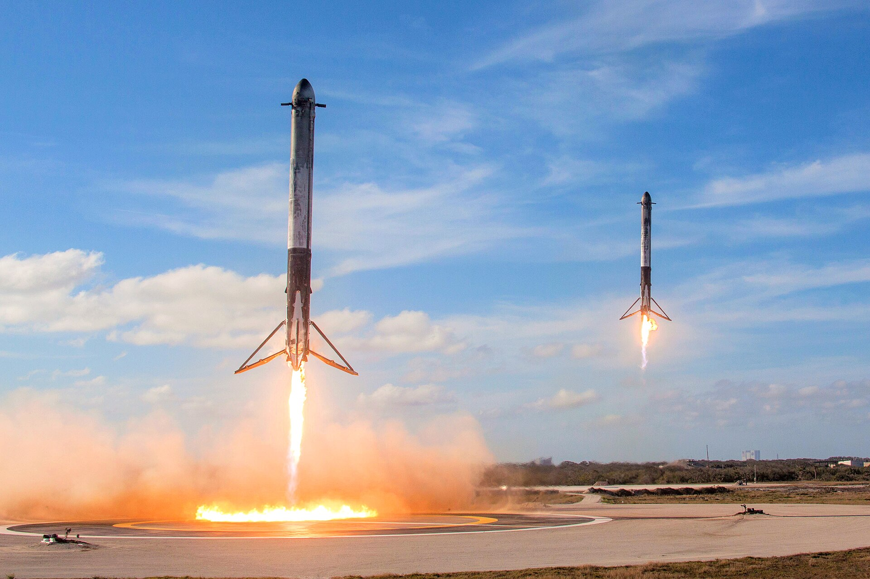
Introduction
As of 16 November 2024, rockets from the Falcon 9 family have been launched 408 times, with 405 full mission successes, three failures(SpaceX 2010)(Wikipedia).
Launching Space Rockets is a multibillion dollar endeavor, that is both crutial to progessing science in the public and private sectors.
Methods to reduce cost and wastes of rocket launches are many such as reusable rockets. However prediction methods of successful launches may be possible in order to reduce chances of failure using know features of successful launches.
We aim to find a model to predict successful launch sites.
SpaceX 2018

Slide 5

Section 1

Slide 6
Methodology
Executive Summary
Data collection methodology:
The data was sourced from the SPACEX RESTfuL API were separated features were combined into one data set. The data was also web scraped from various website such as Wikipedia launch information on spacex heavy carriers
Perform data wrangling
The data was processed and cleaned for specific carrier such as falcon 9 and null values were removed
Perform exploratory data analysis (EDA) using visualization and SQL
Perform interactive visual analytics using Folium and Plotly Dash
Perform predictive analysis using classification models
The model was built using a multiple linear regression model using features engineered from launch site characteristicss
Ebsite such

Slide 7
Data Collection
API (SpaceX API)
JSON to Data fram
Data Cleaning
Data Merging
Data Validation

Slide 8
Data Collection – SpaceX API
https://github.com/oedatainsight/Capsptone-Project-SpaceX/blob/master/jupyter-labs-spacex-data-collection-api-v2.ipynb
ApI call
Data VerificationPlace your flowchart of SpaceX API calls here
JSON Data Retrieved
JSON to DF
SAve to CSV

Slide 9
Data Collection - Scraping
https://github.com/oedatainsight/Capsptone-Project-SpaceX/blob/master/labs-jupyter-spacex-Data%20wrangling-v2.ipynb
Define Data Need
Identify required fields
Identify URLs to scrape
Request Data from Web Pages
Parse HTML Content
Extract Target Data
Clean Extracted Data
|Save Data to File

Slide 10
Data Wrangling
https://github.com/oedatainsight/Capsptone-Project-SpaceX/blob/master/labs-jupyter-spacex-Data%20wrangling-v2.ipynb
Define Data Need
Identify required fields
Identify URLs to scrape
Request Data from Web Pages
Parse HTML Content
Extract Target Data
Clean Extracted Data
|Save Data to File

Slide 11
EDA with Data Visualization
Summarize what charts were plotted and why you used those charts
We used a combination of Line plots that could clearly show difference over time. Scatter plots that can show differences in trends and between groups, and pie charts for clear comparisons of launch rate between groups
https://github.com/oedatainsight/Capsptone-Project-SpaceX/blob/master/jupyter-labs-eda-dataviz-v2.ipynb

Slide 12
EDA with SQL
Using bullet point format, summarize the SQL queries you performed
We used SQL queries to find
The launch sites
Launch sites with CCA
Average Payload carried
First successful landing achieves
Successes in drones
Total number of successful and failed missions
Version carrying the maximum payloads
Counts of landing outcomes in date ranges
https://github.com/oedatainsight/Capsptone-Project-SpaceX/blob/master/jupyter-labs-eda-sql-coursera_sqllite.ipynb

Slide 13
Build an Interactive Map with Folium
The map objects show the location of the launch sites in America with the magnitude of count being the circles and the frequency of successes being the color. WE also marked the proximity to landmarks such as trains and cities for each of the launch sites as features for success.
https://github.com/oedatainsight/Capsptone-Project-SpaceX/blob/master/lab-jupyter-launch-site-location-v2.ipynb

Slide 14
Build a Dashboard with Plotly Dash
We added a pie char to the dashboard for ease and clarity of the proportion of successful launches at each site. We also added a payload VS success fate as that does play a role int eh success rates too.
https://github.com/oedatainsight/Capsptone-Project-SpaceX/blob/master/Dashboard_Ploty.py

Slide 15
Predictive Analysis (Classification)
We made the model using a logistic regression classified to see if we can predict successful launches.
We utilized SVM, KNN, and logistic regression and tested the accuracy against eachother to determine the most accurate model.
We could also test by including and removing features to see if we can get a higher R^2 or higher accuracy
https://github.com/oedatainsight/Capsptone-Project-SpaceX/blob/master/SpaceX-Machine-Learning-Prediction-Part-5-v1.ipynb

Slide 16

Section 2

Slide 17
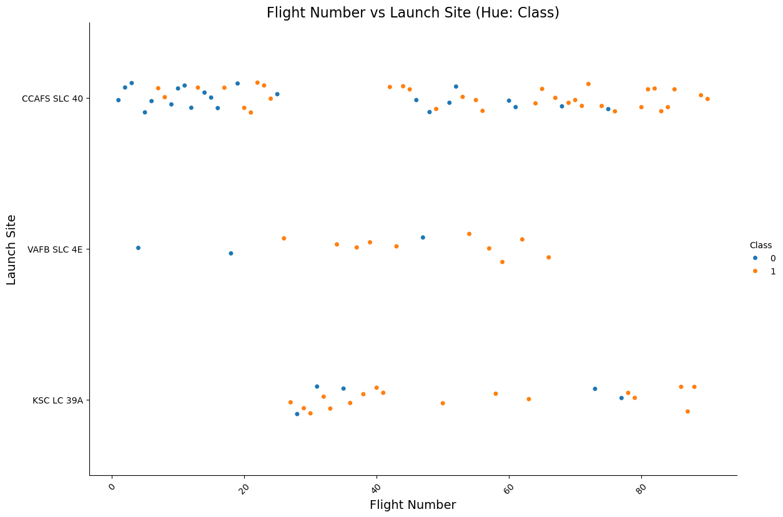
Flight Number vs. Launch Site
Show a scatter plot of Flight Number vs. Launch Site
Show the screenshot of the scatter plot with explanations

Slide 18
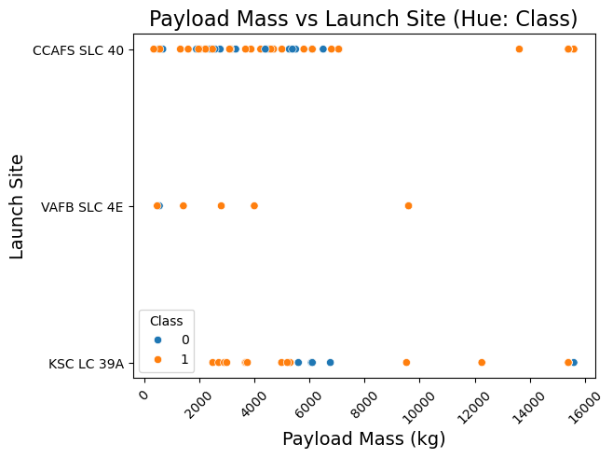
Payload vs. Launch Site
Show a scatter plot of Payload vs. Launch Site
Show the screenshot of the scatter plot with explanations

Slide 19
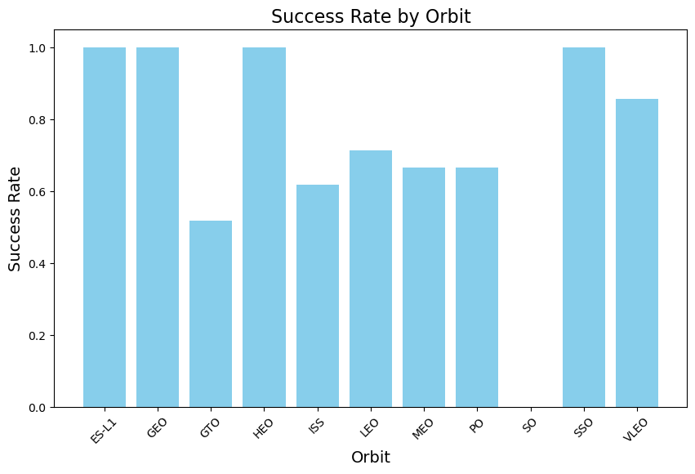
Success Rate vs. Orbit Type
Show a bar chart for the success rate of each orbit type
Show the screenshot of the scatter plot with explanations

Slide 20
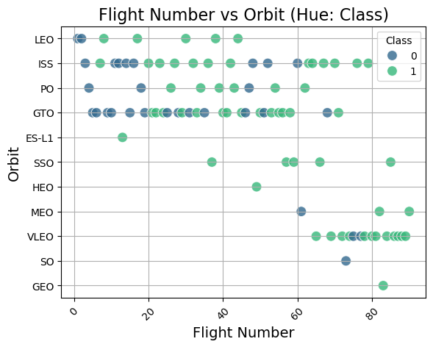
Flight Number vs. Orbit Type
Show a scatter point of Flight number vs. Orbit type
Show the screenshot of the scatter plot with explanations

Slide 21
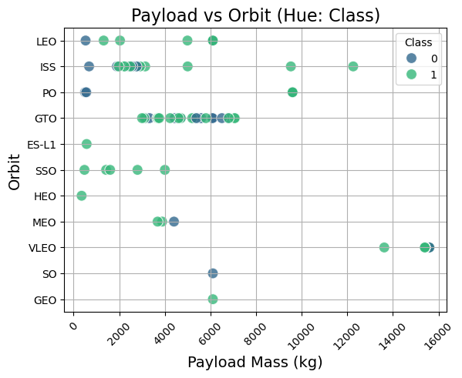
Payload vs. Orbit Type
Show a scatter point of payload vs. orbit type
Show the screenshot of the scatter plot with explanations

Slide 22
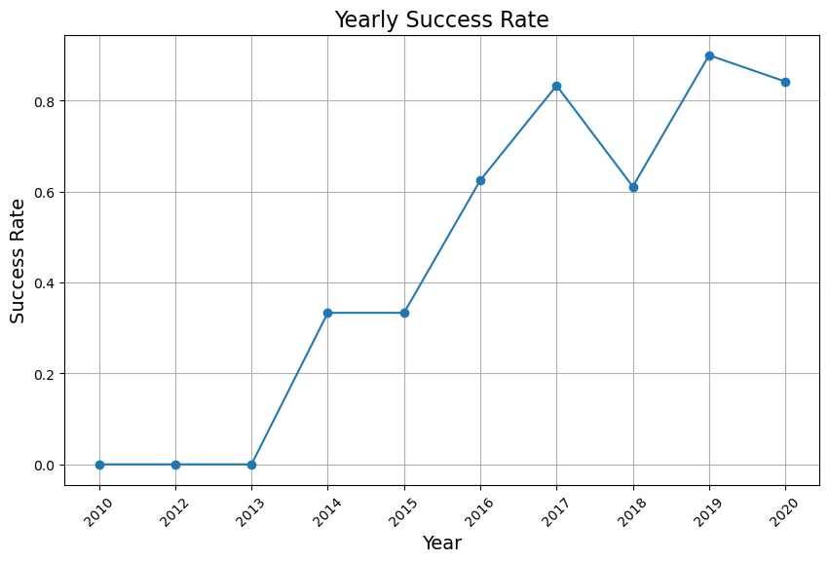
Launch Success Yearly Trend
Show a line chart of yearly average success rate
Show the screenshot of the scatter plot with explanations

Slide 23
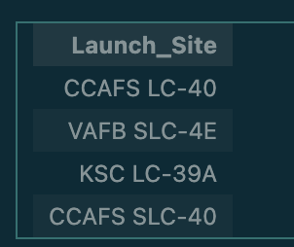
All Launch Site Names
Find the names of the unique launch sites
Present your query result with a short explanation here
%sql SELECT DISTINCT "Launch_Site" FROM SPACEXTABLE;

Slide 24
Launch Site Names Begin with 'CCA'
Find 5 records where launch sites begin with `CCA`
Present your query result with a short explanation here
%sql SELECT * FROM SPACEXTABLE WHERE "Launch_Site" LIKE 'CCA%' LIMIT 5;
Date | Time (UTC) | Booster_Version | Launch_Site | Payload | PAYLOAD_MASS__KG_ | Orbit | Customer | Mission_Outcome | Landing_Outcome
2010-06-04 | 18:45:00 | F9 v1.0 B0003 | CCAFS LC-40 | Dragon Spacecraft Qualification Unit | 0 | LEO | SpaceX | Success | Failure (parachute)
2010-12-08 | 15:43:00 | F9 v1.0 B0004 | CCAFS LC-40 | Dragon demo flight C1, two CubeSats, barrel of Brouere cheese | 0 | LEO (ISS) | NASA (COTS) NRO | Success | Failure (parachute)
2012-05-22 | 7:44:00 | F9 v1.0 B0005 | CCAFS LC-40 | Dragon demo flight C2 | 525 | LEO (ISS) | NASA (COTS) | Success | No attempt
2012-10-08 | 0:35:00 | F9 v1.0 B0006 | CCAFS LC-40 | SpaceX CRS-1 | 500 | LEO (ISS) | NASA (CRS) | Success | No attempt
2013-03-01 | 15:10:00 | F9 v1.0 B0007 | CCAFS LC-40 | SpaceX CRS-2 | 677 | LEO (ISS) | NASA (CRS) | Success | No attempt

Slide 25
Total Payload Mass
Calculate the total payload carried by boosters from NASA
%sql SELECT SUM("PAYLOAD_MASS_KG_") AS TotalPayload FROM SPACEXTABLE WHERE "Customer" LIKE '%NASA%';
Present your query result with a short explanation here

Slide 26
Average Payload Mass by F9 v1.1
Calculate the average payload mass carried by booster version F9 v1.1
%sql SELECT AVG("PAYLOAD_MASS_KG_") AS AveragePayload FROM SPACEXTABLE WHERE "Booster_Version" = 'F9 v1.1';
Present your query result with a short explanation here

Slide 27
First Successful Ground Landing Date
Find the dates of the first successful landing outcome on ground pad
Present your query result with a short explanation here
%sql SELECT "Date" FROM SPACEXTABLE WHERE "Landing_Outcome" = 'Success (ground pad)' ORDER BY "Date" ASC LIMIT 1;
Date
2015-12-22

Slide 28
Successful Drone Ship Landing with Payload between 4000 and 6000
List the names of boosters which have successfully landed on drone ship and had payload mass greater than 4000 but less than 6000
%sql SELECT "Booster_Version" FROM SPACEXTABLE WHERE "Landing_Outcome" = 'Success (drone ship)' AND "PayloadMass" > 4000 AND "PayloadMass" < 6000;
Present your query result with a short explanation here

Slide 29
Total Number of Successful and Failure Mission Outcomes
Calculate the total number of successful and failure mission outcomes
SELECT * SUM("Class") AS Total_Success, COUNT(*) - SUM("Class") AS Total_Failure
FROM SPACEXTABLE;
Present your query result with a short explanation here

Slide 30
Boosters Carried Maximum Payload
List the names of the booster which have carried the maximum payload mass
%sql SELECT DISTINCT "Booster_Version" FROM SPACEXTABLE WHERE "PayloadMass" = (SELECT MAX("PayloadMass") FROM SPACEXTABLE) LIMIT 20;
Present your query result with a short explanation h
there were several more but we have truncated the list for clarity
booster_Version
F9 v1.0 B0003
F9 v1.0 B0004
F9 v1.0 B0005
F9 v1.0 B0006
F9 v1.0 B0007
F9 v1.1 B1003
F9 v1.1
F9 v1.1 B1011
F9 v1.1 B1010
F9 v1.1 B1012
F9 v1.1 B1013
F9 v1.1 B1014
F9 v1.1 B1015
F9 v1.1 B1016
F9 v1.1 B1018
F9 FT B1019
F9 v1.1 B1017
F9 FT B1020
F9 FT B1021.1
F9 FT B1022

Slide 31
2015 Launch Records
List the failed landing_outcomes in drone ship, their booster versions, and launch site names for in year 2015
%sql SELECT "Landing_Outcome", "Booster_Version", "LaunchSite" FROM SPACEXTABLE WHERE "Landing_Outcome" = 'Failure (drone ship)' AND strftime('%Y', "Date") = '2015';
Landing_Outcome Booster_Version "LaunchSite"
Failure (drone ship) F9 v1.1 B1012 LaunchSite
Failure (drone ship) F9 v1.1 B1015

Slide 32
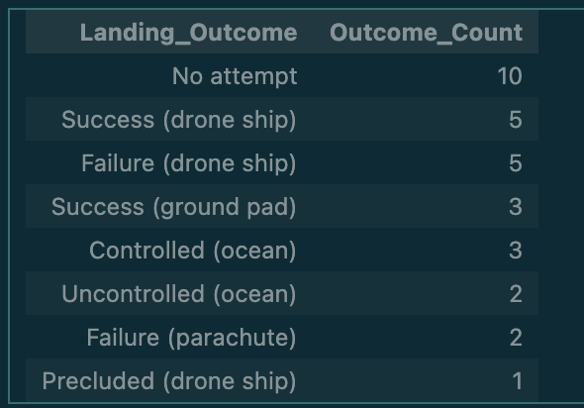
Rank Landing Outcomes Between 2010-06-04 and 2017-03-20
Here we rank the count of landing outcomes between the date 2010-06-04 and 2017-03-20, in descending order
%sql SELECT "Landing_Outcome", COUNT(*) AS Outcome_Count FROM SPACEXTABLE WHERE "Date" BETWEEN '2010-06-04' AND '2017-03-20' GROUP BY "Landing_Outcome" ORDER BY Outcome_Count DESC;

Slide 33

Section 3

Slide 34
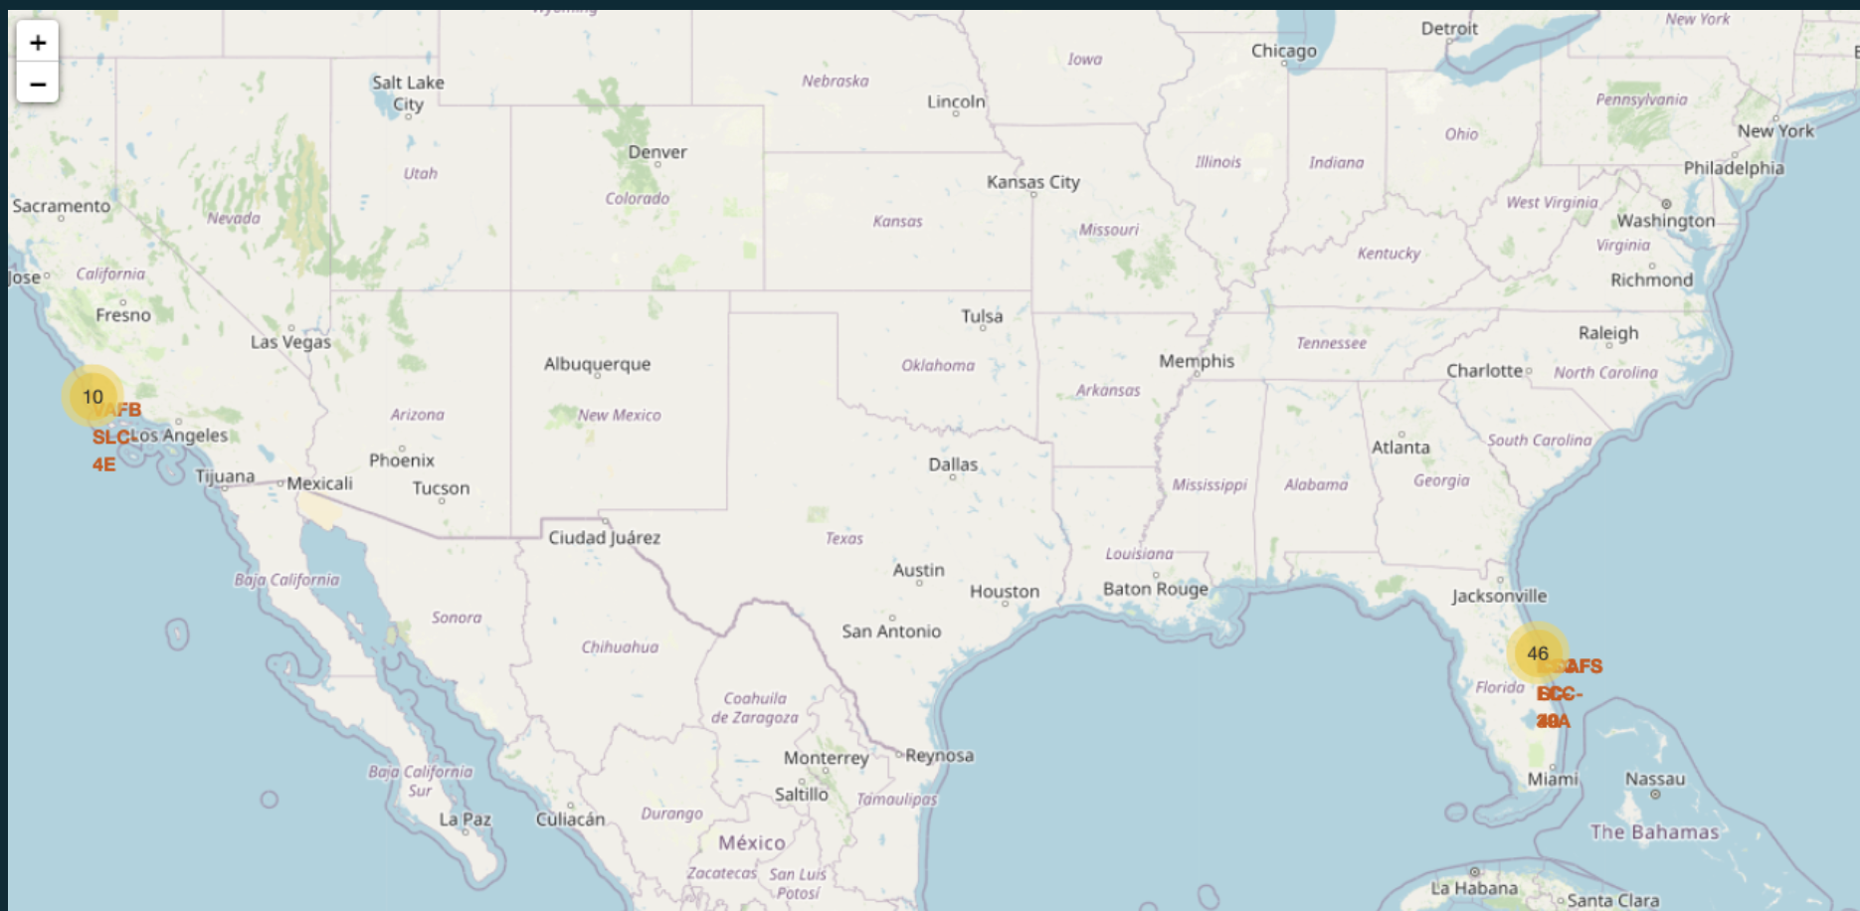
Launch Site Analysis
Explore the generated folium map and make a proper screenshot to include all launch sites’ location markers on a global map
Explain the important elements and findings on the screenshot

Slide 35
Launch Outcomes per Launch Site
Explore the folium map and make a proper screenshot to show the color-labeled launch outcomes on the map
Explain the important elements and findings on the screenshot

Slide 36
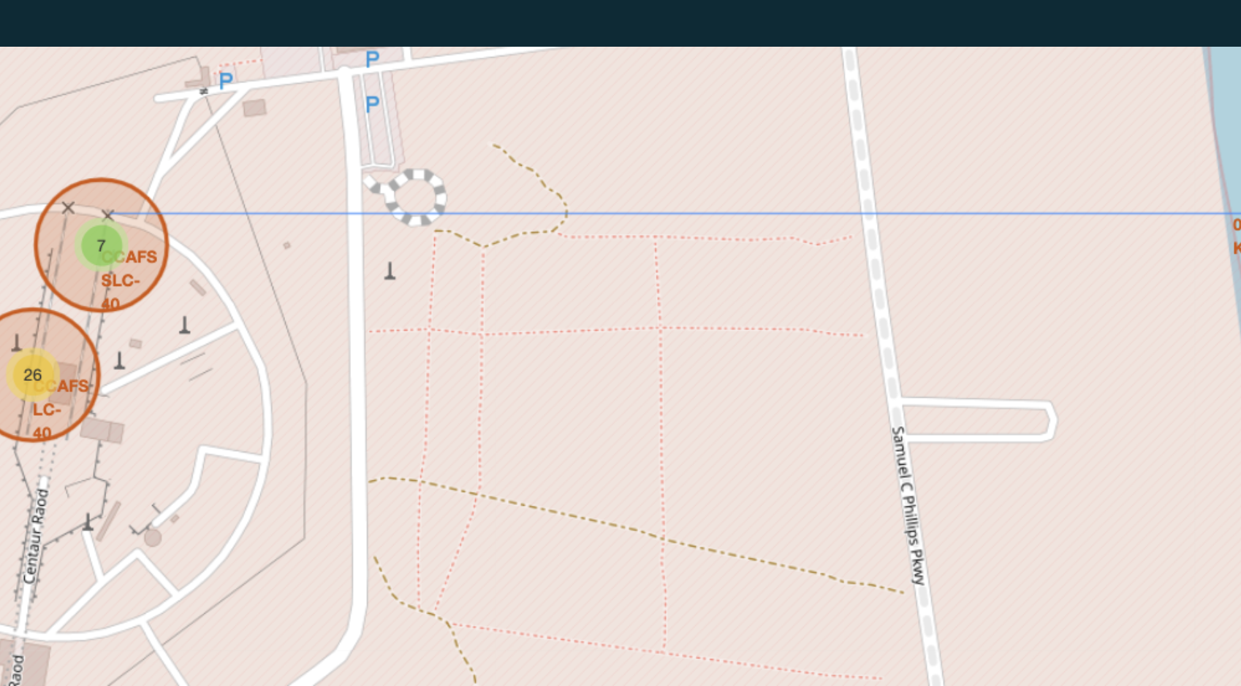
Proximities Calculations to launch Site
Launch site displayed as proximal to landmarks such as railways and cities as a factor for launch site success

Slide 37

Section 4

Slide 38
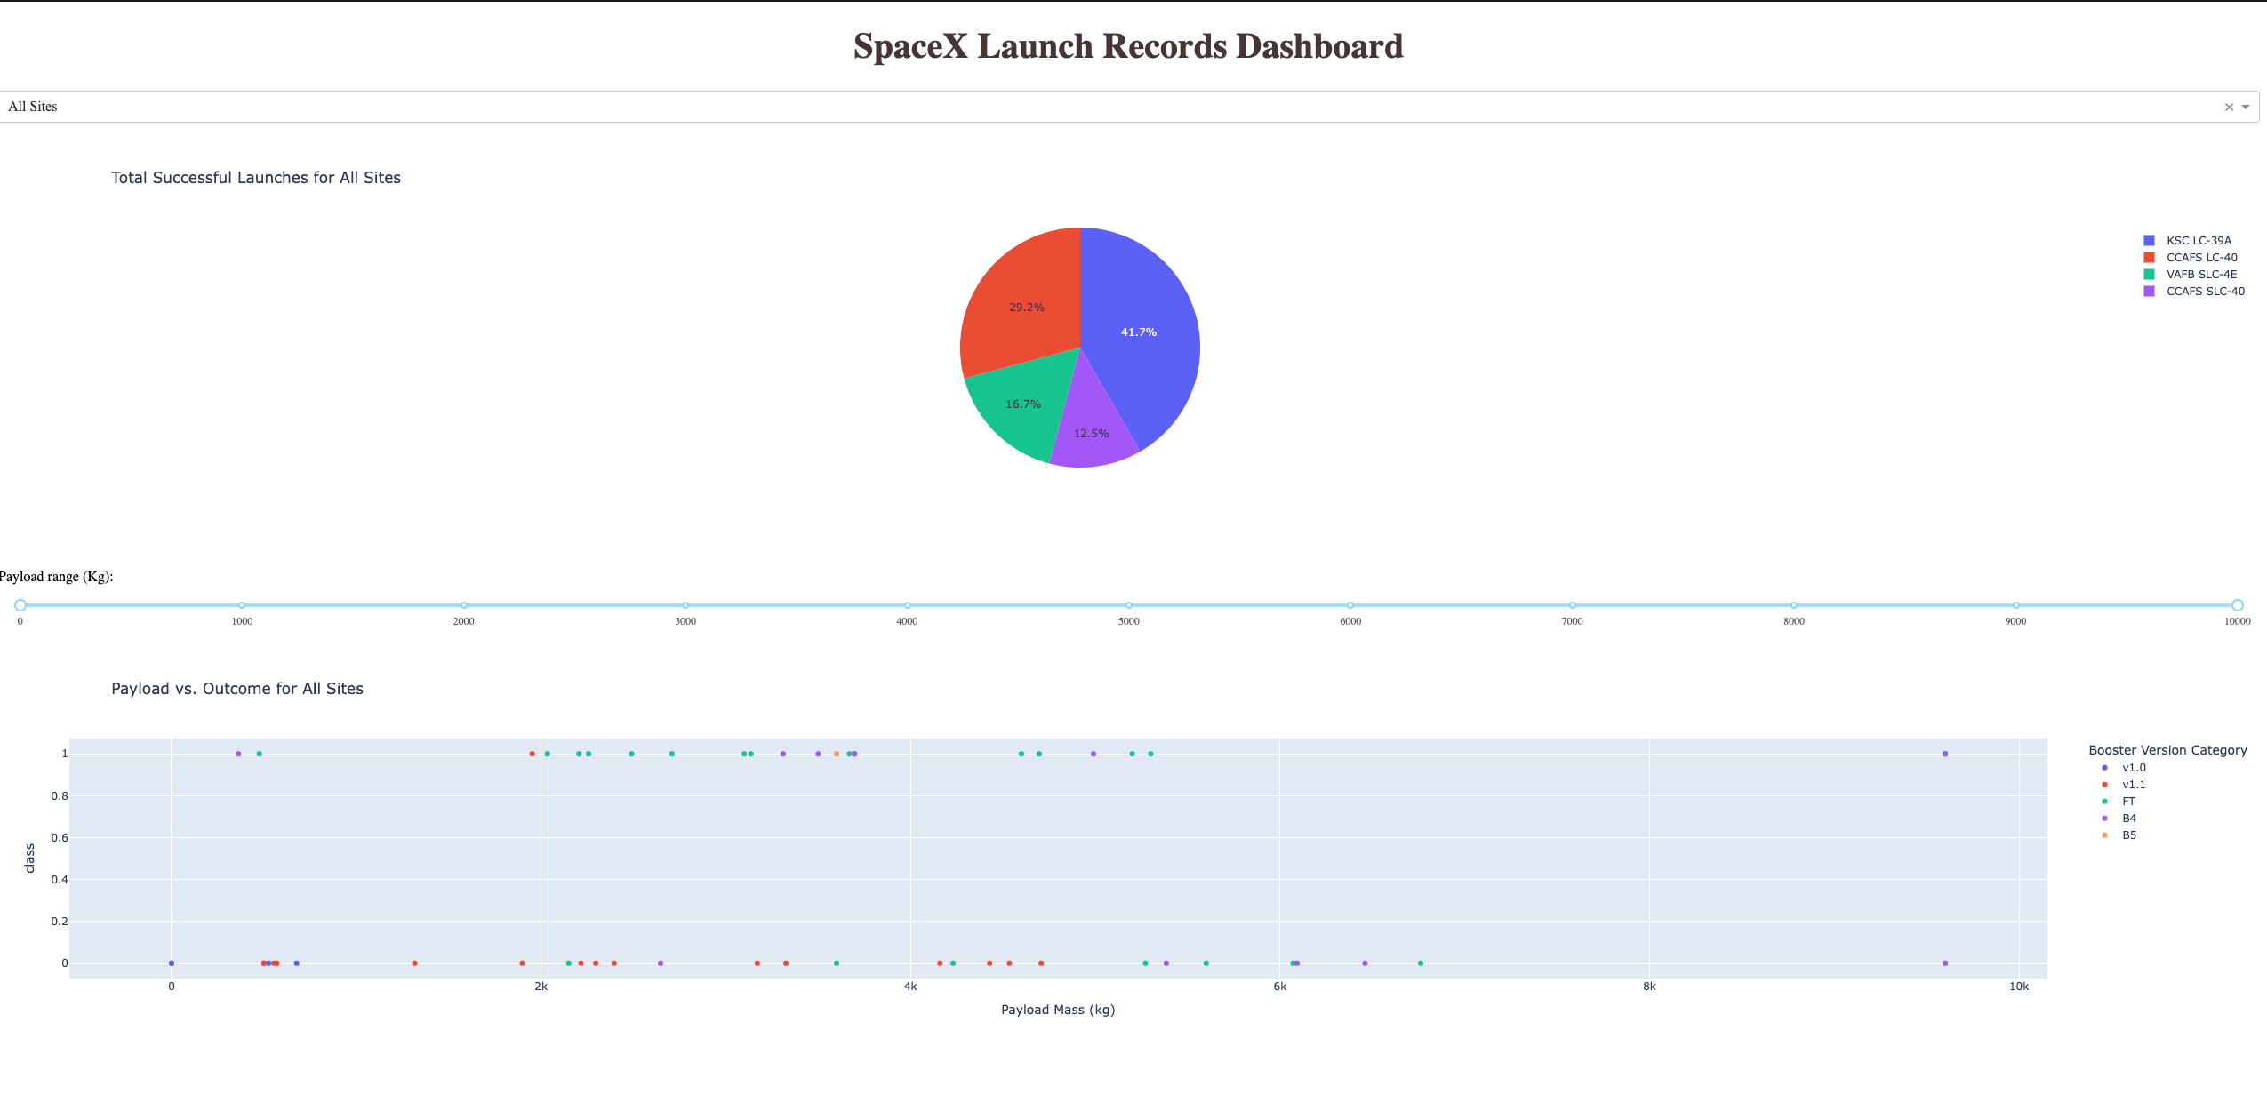
Launch Success Counts per Site

Slide 39
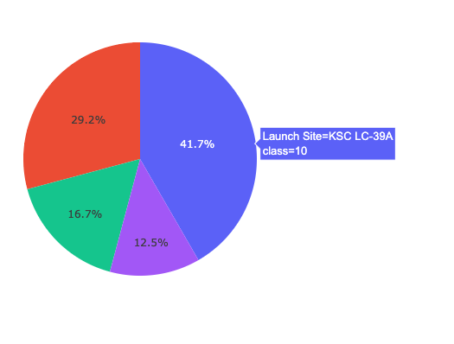
Highest Launch site Ratio
KSC LC-389A Class 10 with a record of 41.7% launches that were successful in this site

Slide 40
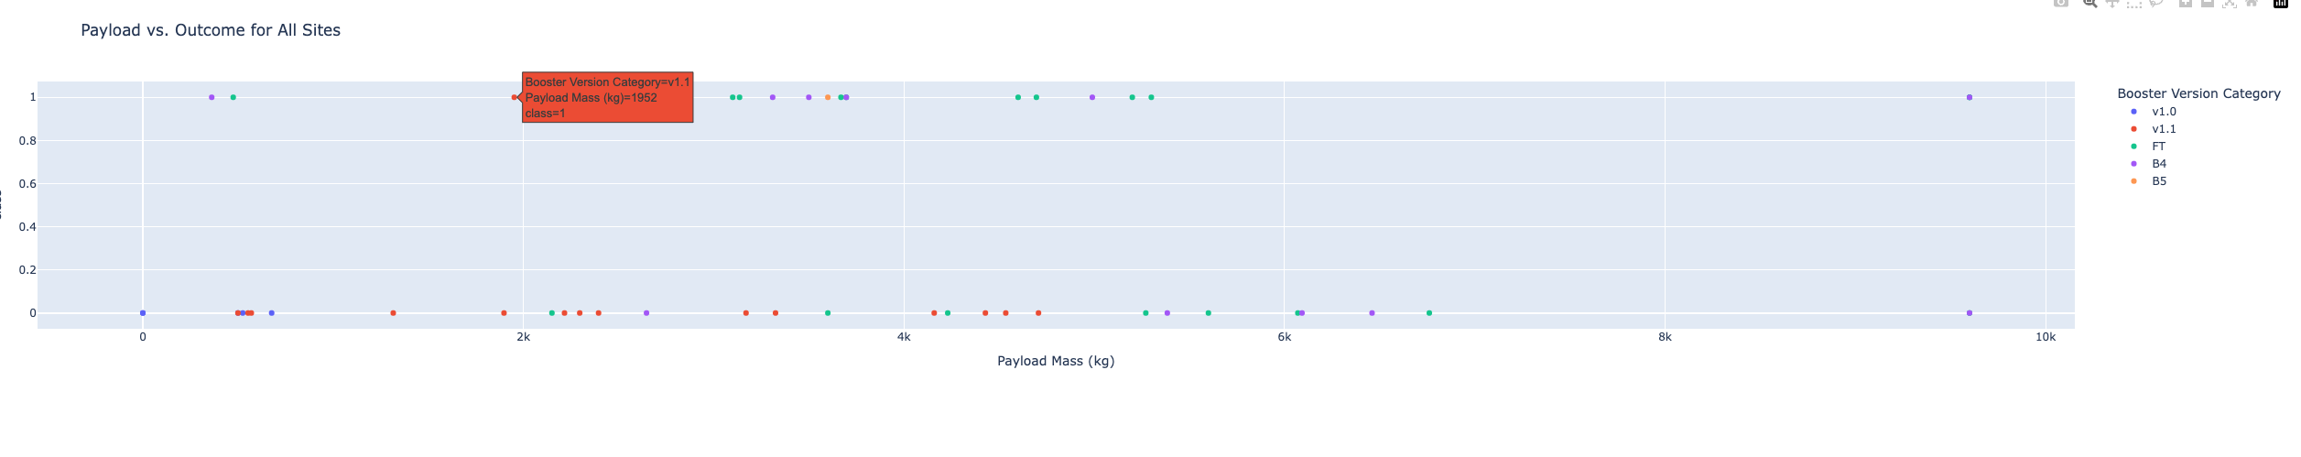
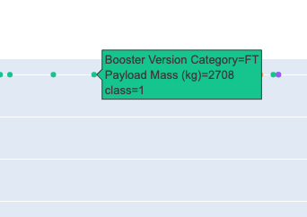
Payload Vs. Launch Outcomes
This is a Dashboard Representation of the Payload vs launch outcomes

Slide 41

Section 5

Slide 42
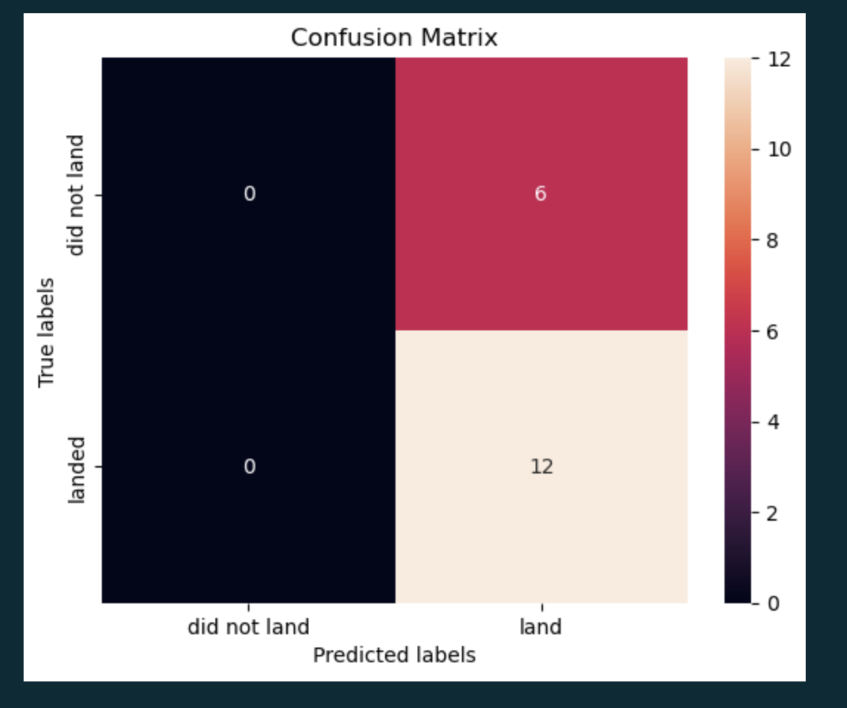
Confusion Matrix
Show the There is a high miss rate in the confusion matrix when predicted true labels of that that did not land

Slide 43
Conclusions
Logisitic regression preformed the best to predict successful launches
SVM was close but took too long to run.
There may be other factors that contribute to successful launches.
More research needs to be done and data collected

Slide 44
Appendix
https://github.com/oedatainsight/Capsptone-Project-SpaceX/blob/master/spacex_launch_geo.csv
https://github.com/oedatainsight/Capsptone-Project-SpaceX/blob/master/spacex_launch_dash.csv
https://github.com/oedatainsight/Capsptone-Project-SpaceX/blob/master/Dashboard_Ploty.py

Slide 45
Classification Accuracy
Visualize the built model accuracy for all built classification models, in a bar chart
Find which model has the highest classification accuracy

Slide 46


